Slide 1
Profit Dutch courage auction house

Slide 2
Agenda
Introduction
How we did it
First round
Changes between rounds
Second round
Total profit
Future

Slide 3



Introduction

Slide 4
How we did it​
Took the average bids from previous rounds
Calculated the expected profit per auction
Made bids based on the previous bids on each auction (more if expected to be good)
Random change for confusing similar smart algorithms
Had multipliers so we could change the amount when being in the auctions

Slide 5
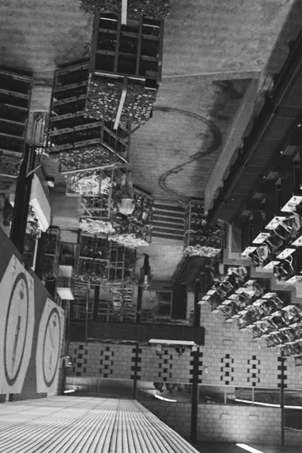
First round

Slide 6
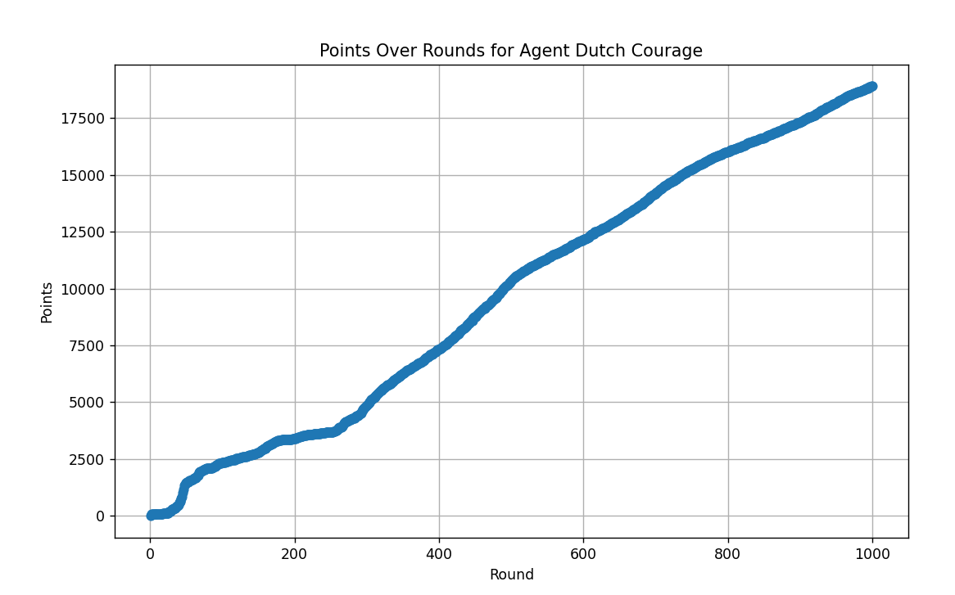

Slide 7
Changes between rounds
Made the bids more aggressive
Stopped bidding on the auctions with the lowest payout
Decreased the change of biding a lot on one auction
A lot of auctions were lost because of low bids
This way we could bid more on high payout auctions
There were no good learning bots that needed to be confused

Slide 8
Second round

Slide 9
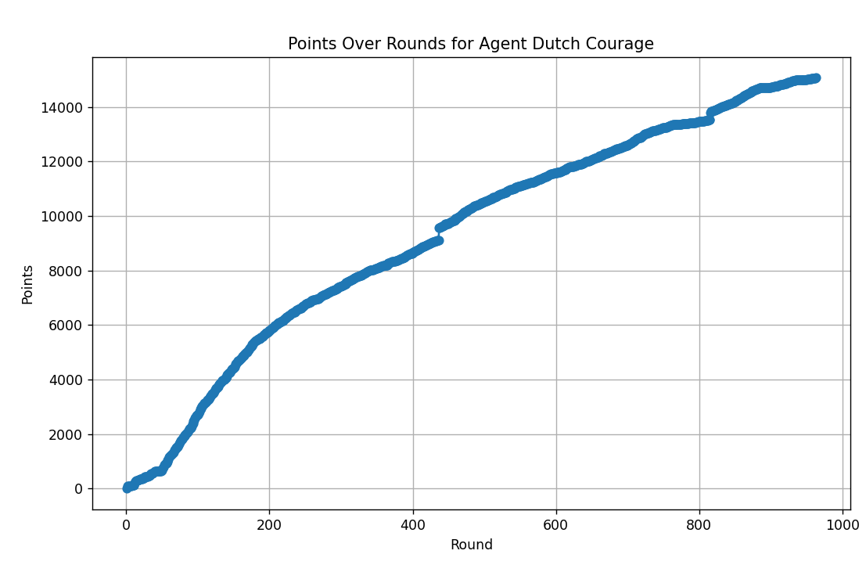

Slide 10
Total profit
32424

Slide 11
Future
More points
By better predictions or a more robust algorithm

